Slide 1
Capsule Companion The Holographic Health Coach and Medication Monitor!
Psychedelic Psychologists

Slide 2
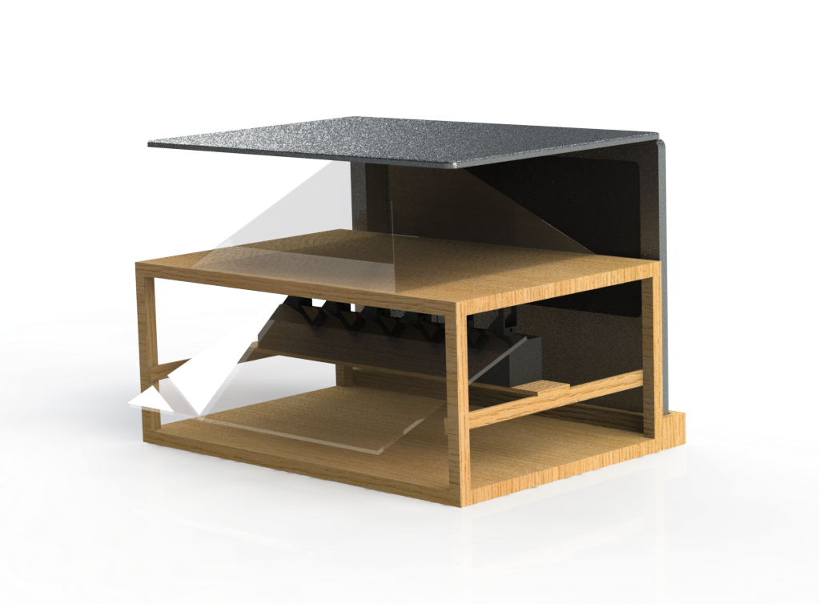
Main Body

Slide 3
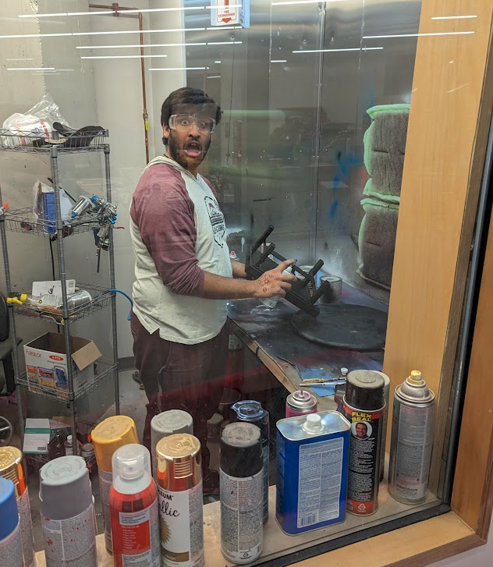
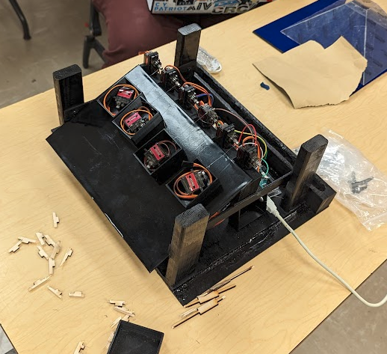
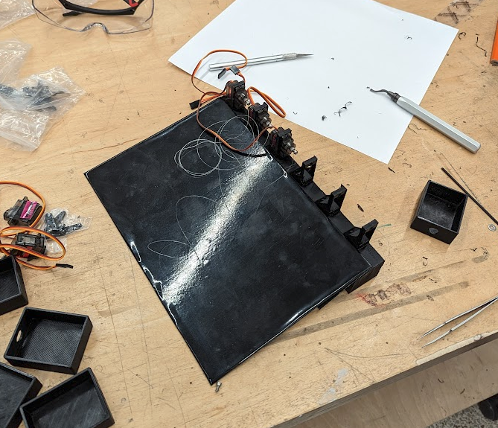

Slide 4
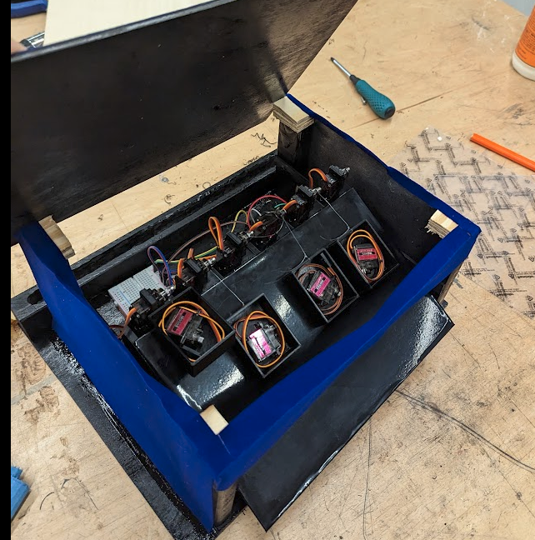
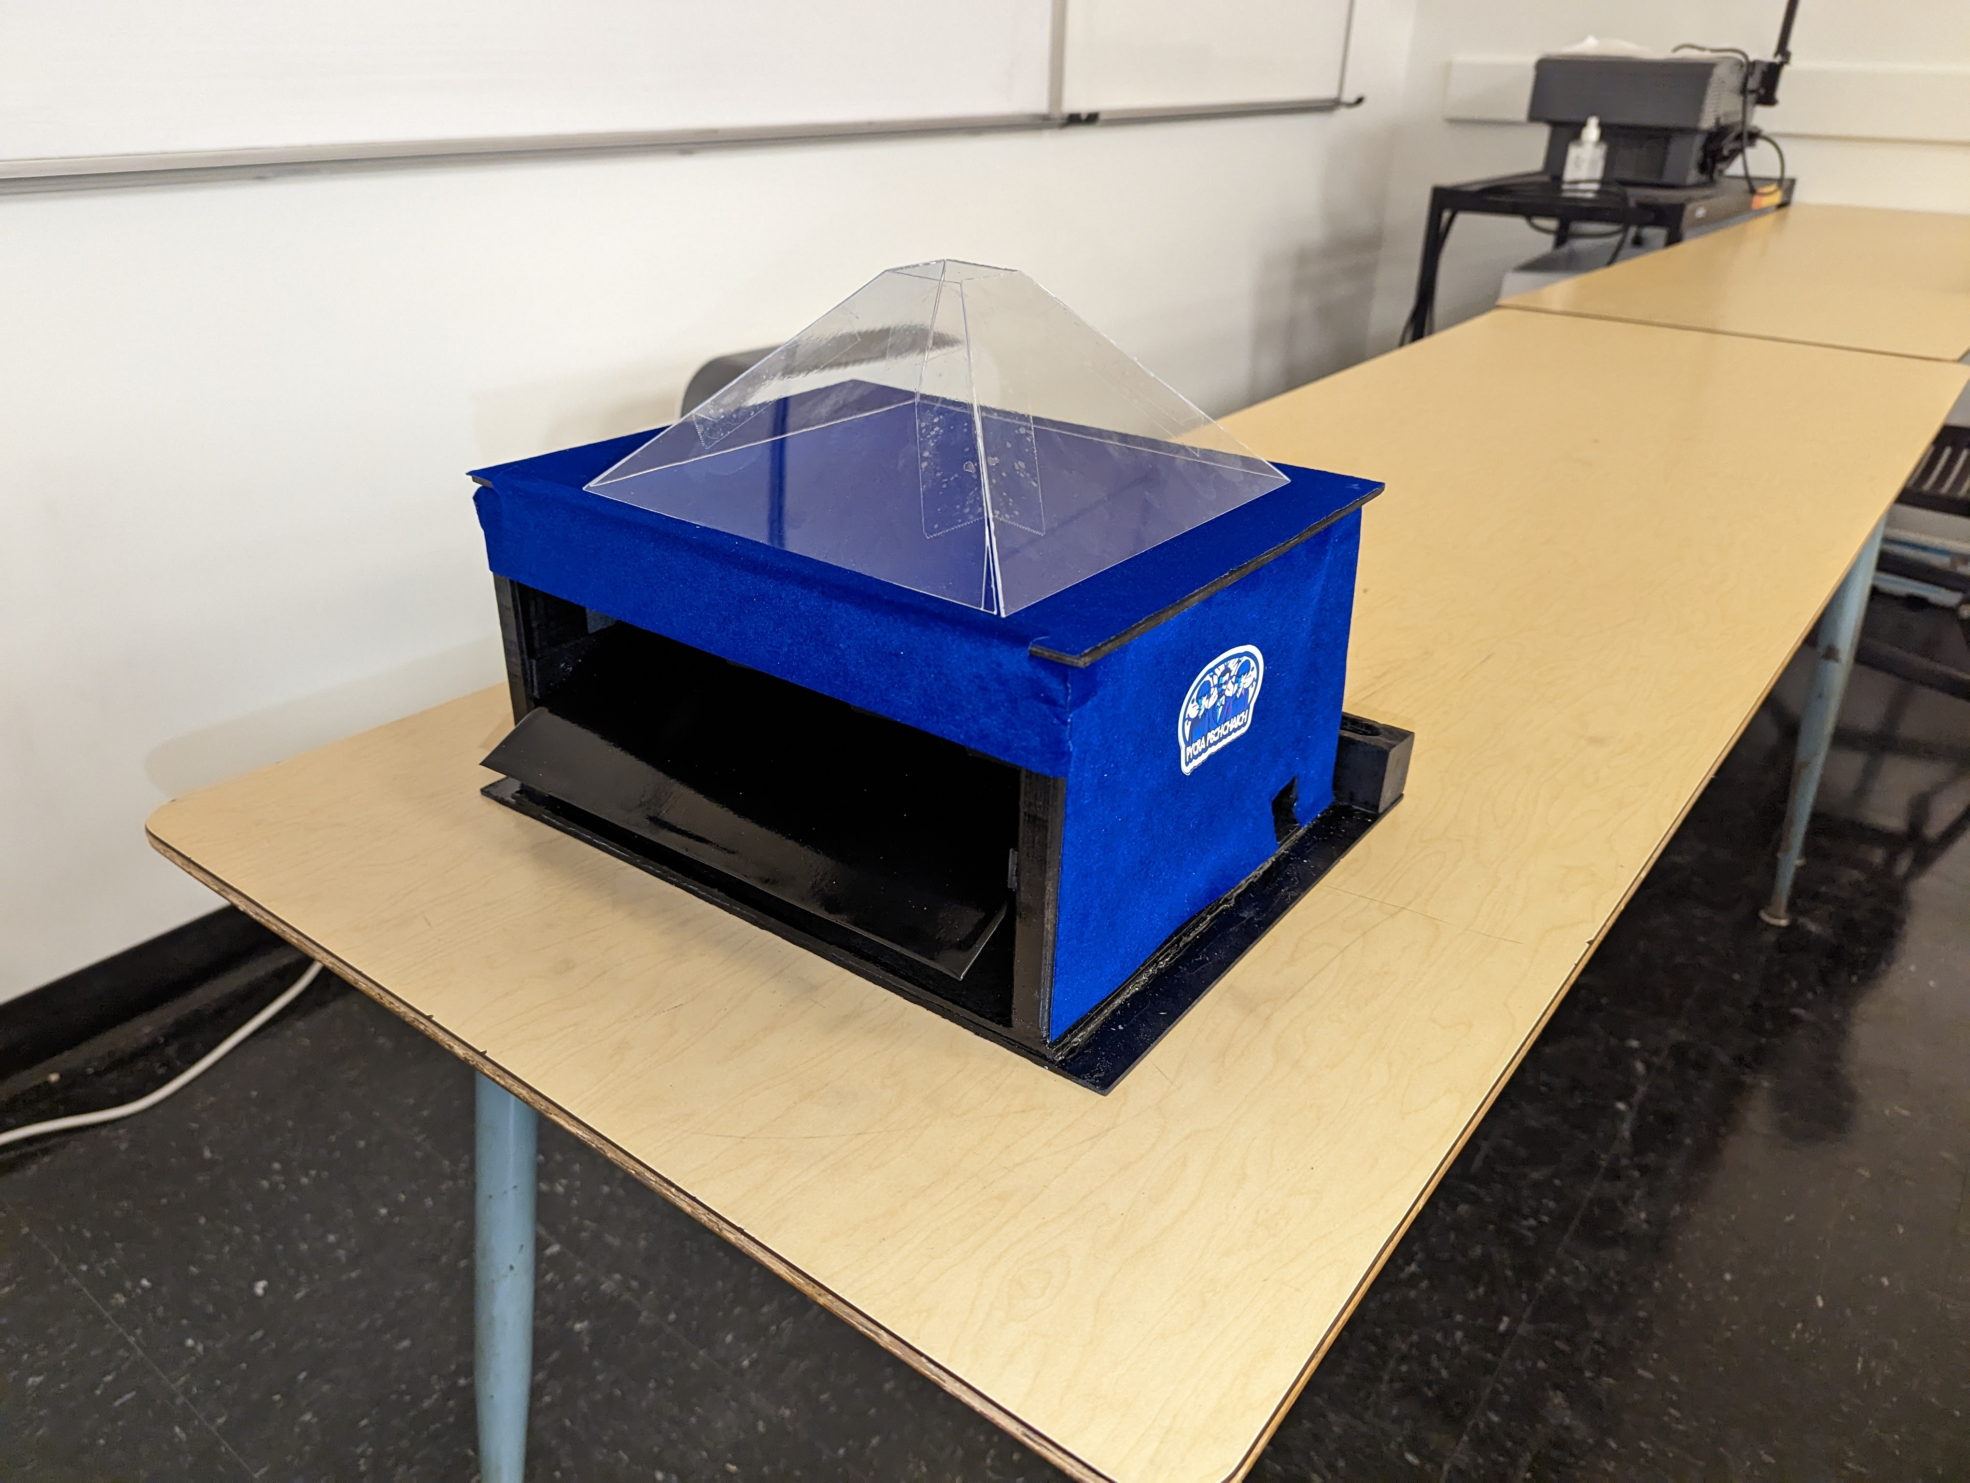

Slide 5

Hologram

Slide 6
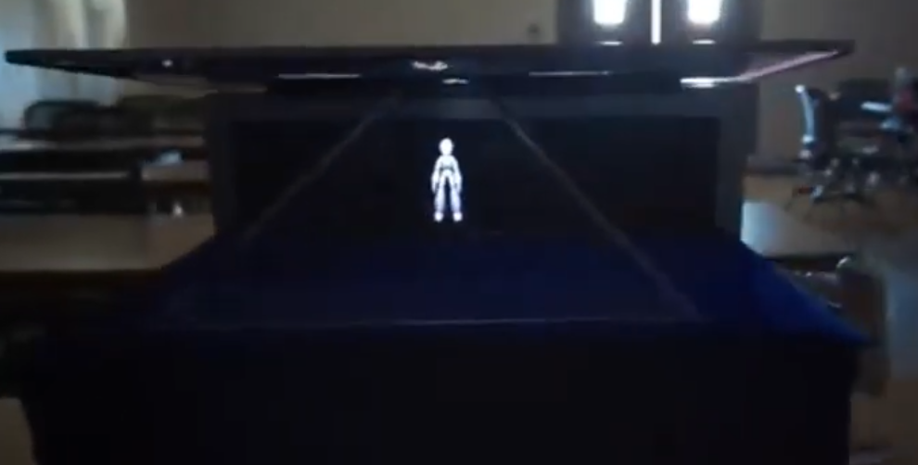

Slide 7

Pill Dispensing

Slide 8
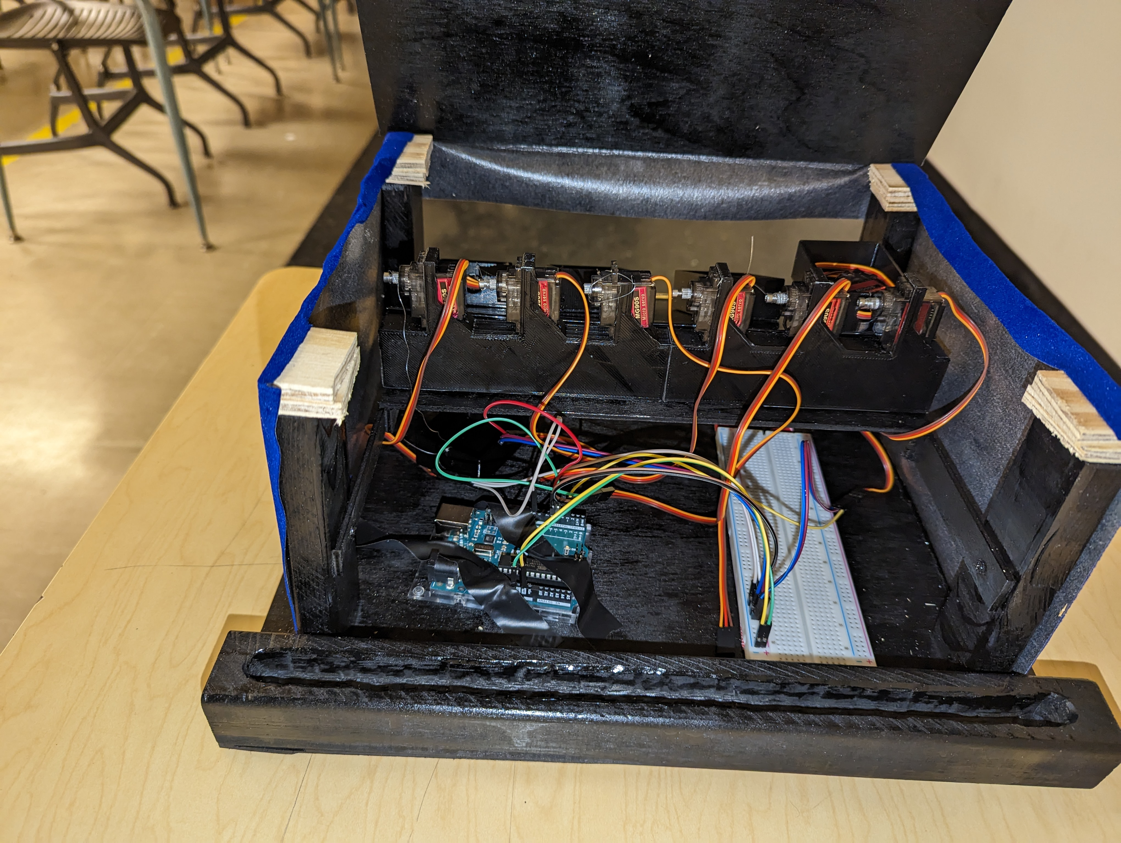

Slide 9


Slide 10

Not a Smart Home Assistant

